Slide 1
Moodle VLE
Optimising engagement is by being:
Appealing
Functional &
Informative
Images of groups of young people, smiling and being tactile, are the most appealing.
Simple and repeated navigation, is the most functional.
Methods for ensuring participation, the names and contact details of people providing support, and the presentation of the wider context, are the most informative.
page 1 of 4

Slide 2
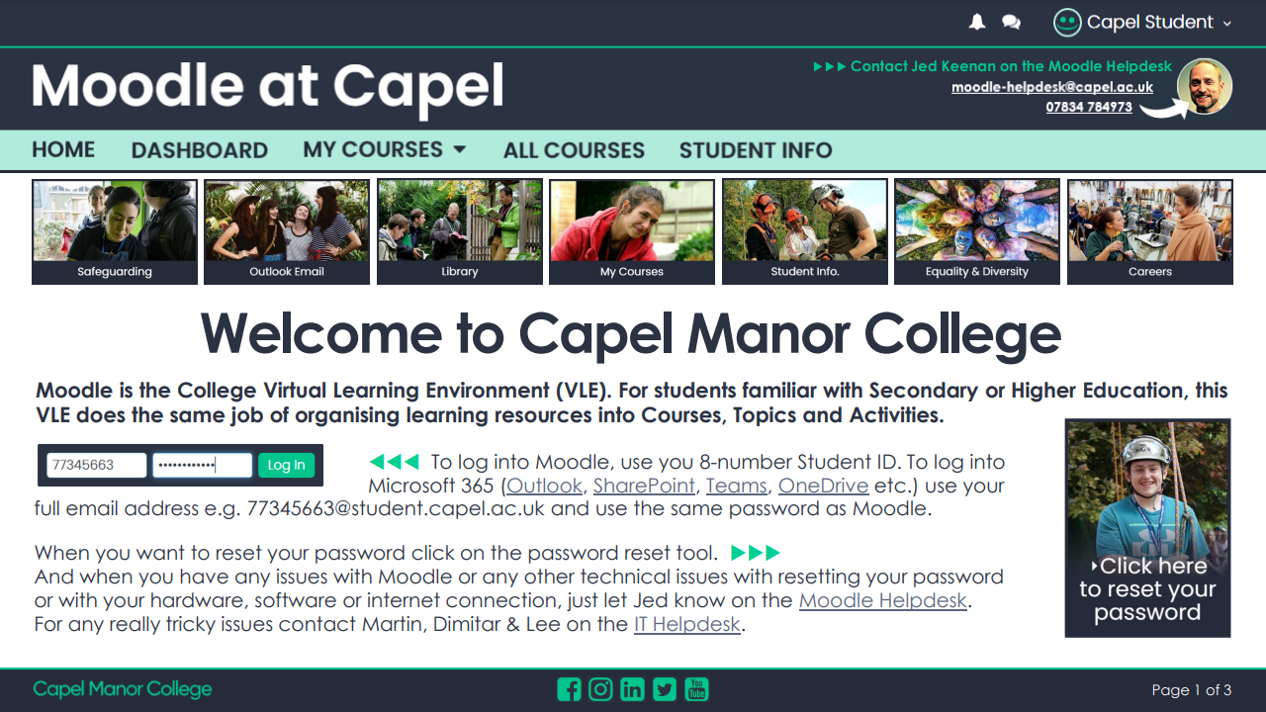
Moodle VLE
Calls to action, invitations to get in contact, and clear directions, make learners feel engaged.
Augmented PDF documents as a standard, optimises learner engagement.
page 2 of 4

Slide 3
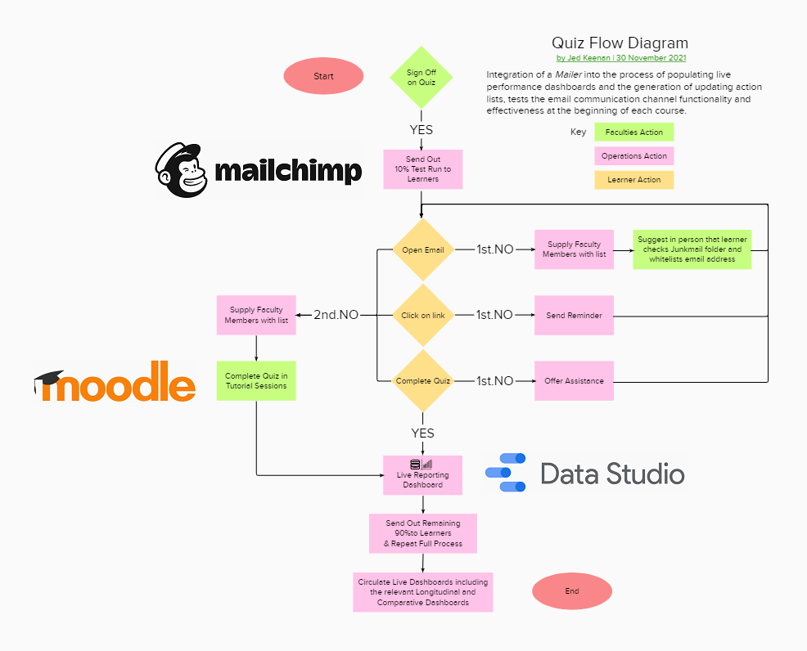
Moodle VLE
Initial assessment for every class, topic and module, is the basis of a differentiated provision.
For every initial assessment, 100% learner engagement is standard.
page 3 of 4

Slide 4
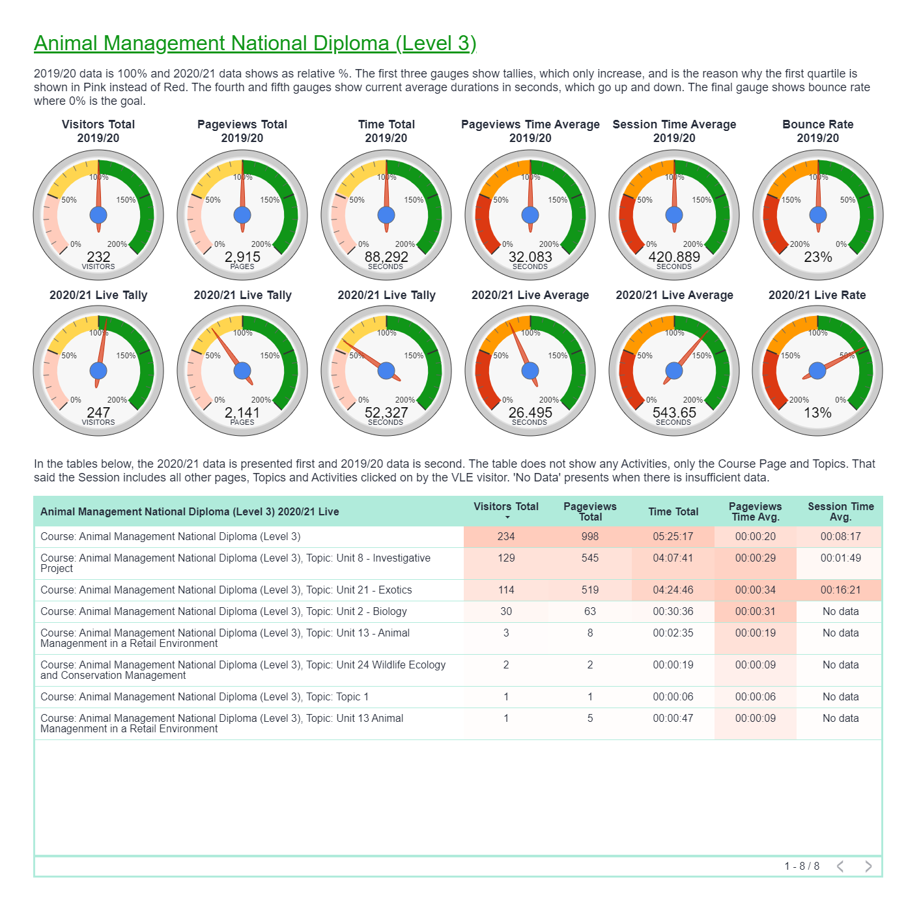
Moodle VLE
Live Dashboards for every level, is the basis for optimisation.
Organisation
Department
Class & Course
Individual Learners
Longitudinal comparison with previous performance, and evaluation between Learners, Classes, Courses, and Departments, is the metric for optimisation.
page 4 of 4

